Slide 1
Managing Information Technology Resources ITWS 4310
Risk Management
Probability and Statistics
In-Class Risk Exercises
September 27, 2018

Slide 2
Managing IT Resources Class Outline: Thurs, Sept 27, 2018
MITR Term Project
Schedule Meetings with Client and Invite Faculty to Meetings
Work on “System Requirements” with Client due as part of “Initial Sections” on Oct 9 by 9 PM
How to Do a Business Case – 1st Business Case is “Netflix” with Case Answers due prior to class on Tues Oct 9 (Monday class schedule)
Quiz
Current Events
Probability and Statistics as applied to MITR
Risk Management In-Class Exercise for All Students due Sat Sept 29 by 9 PM
Risk Management Term Project Assignment for All Teams due as part of “Initial Sections” due Tues Oct 9 by 9 PM
Mid-Term Exam on Monday Oct 15 during class-time from 10 AM – 12 PM

Slide 3
Managing IT Resources: ITWS 4310 Term Project Report Outline
Section 1: Executive Summary
Section 2: Introduction
Section 3: Client Organization and Description
Section 4: Project Team
Section 5: Problem Statement
Section 6: IS/IT Solution
Section 7: Methodology
Section 8: IS/IT Requirements
Section 9: IS/IT Design
Section 10: Cost-Benefit Analysis
Section 11: Project Plan/Schedule/Resources
Section 12: Post-Turnover Plan
Section 13: Results and Client Feedback
Section 14: Conclusions
Project Proposal:
Requirements
Part of Initial Sections:
due Oct 9 by 9 PM
Cost-Benefit Analysis
Project Plan

Slide 4
Managing IT Resources: ITWS 4310 Term Project Thoughts
Establish Roles for each member of the Team and communicate those Roles to the Client
Project Manager
Technical Manager
Financial Manager
Client Liaison – Single point of contact for all client communications (copy all team members and instructor) – dual role for PM?
Establish regular meetings with Client
Have an agenda published before meeting
Always start and end on time
Project Manager chairs meeting
Always thank client for their time and support
Always send meeting minutes
Establish regular team meetings
Project Manager chairs meeting
Have an agenda and run meetings efficiently
Every member arrives on time and contributes
Every member turns in their portion of project deliverables on time to team for integration

Slide 5
Business Case Analysis
Read the Case.
The Case is a “story” about a relevant IT company or situation intended to provide experiential learning about the topics in this course.
Read the Case Questions.
Re-read the case with the questions in mind.
Research material about the company on its website, financial sites (www.reuters.com/finance/stocks, www.google.com/finance, www.finance.yahoo.com), and other current media.
Think about the Case questions. You are encouraged to meet in groups to discuss the case questions.
Be prepared to discuss and answer all the Case Questions during class.
Write and submit the answer to the one written Case question that is to be submitted on LMS individually prior to class (9:59 AM)
Hard deadline – miss this deadline and maximum points for a case assignment falls to 70%

Slide 6
How to Write the Business Case
Do not simply summarize the Case.
Be sure to Answer the Question(s).
The length should be 1-2 pages, single-spaced, 12 point font with normal borders.
Use both qualitative and quantitative arguments to support your answer.
Use concepts and data from the Case and the FWK textbook.
Use concepts and data from online research.
Show insight. It is ok to include personal knowledge.
Words without numbers are fair at best.
Numbers without words are fair at best.
Use good quality English language: style, rhetoric, grammar, spelling, references.

Slide 7
Quiz #2 10 Minutes

Slide 8
Technology Current Events: “With Sirius behind it, can Pandora now stage a comeback?”, USA Today, Sept 25, 2018. https://www.usatoday.com/story/tech/talkingtech/2018/09/25/sirius-xm-pandora-comeback/1416707002/
We've loved Pandora for years. Perhaps we forgot about her and moved onto new friends, like Spotify, Apple Music or Amazon.
But can she now bounce back with a $3.5 billion investment? That's the question many asked Monday, in the wake of Sirius XM's proposed purchase of the struggling Pandora music service, one of the oldest Internet brands, dating back to the early oughts.
We all love free music. So what if YouTube's new Music service does a better job of identifying our likes and dislikes, based on our Google search history? Or if more people have gotten used to the Spotify interface?
Pandora was there first. We know it. It's easy to use. We have a history with Pandora.
Announced Monday, the merger puts the smaller, but wealthier Sirius, which has just over 30 million paying subscribers, as the new owner of Pandora, home to 70 million active mostly ad-supported listeners. Pandora has long been popular with listeners as a place to hear free music, but not on demand. Instead, you could pick a song or artist and create radio stations based on them, with only a handful of songs based on your picks during the hour, due to copyright laws.

Slide 9
Technology Current Events: “Instagram co-founders resign in latest Facebook executive exit”, Yahoo! Finance, Sept 25, 2018. https://finance.yahoo.com/news/instagram-co-founders-step-down-company-york-times-021610965--finance.html
Instagram on Monday said co-founders Kevin Systrom and Mike Krieger have resigned as chief executive officer and chief technical officer of the photo-sharing app owned by Facebook Inc, giving scant explanation for the move.
The departures at Facebook's fastest-growing revenue generator come just months after the exit of Jan Koum, co-founder of Facebook-owned messaging app WhatsApp, leaving the social network without the developers behind two of its biggest services.
They also come at a time when Facebook's core platform is under fire for how it safeguards customer data, as it defends against political efforts to spread false information, and as younger users increasingly prefer alternative ways to stay in touch with family and friends. Concerns over Facebook's business sparked the biggest one-day wipeout in U.S. stock market history in July.
Systrom wrote in a blog post on Monday that he and Krieger planned to take time off and explore "our curiosity and creativity again".
Their announcement came after increasingly frequent clashes with Facebook Chief Executive Mark Zuckerberg over the direction of Instagram, Bloomberg reported.
In a statement, Zuckerberg described the two as "extraordinary product leaders".

Slide 10
Technology Current Events: “Amazon Comes Up With Another Way to Get Alexa Into Your Home”, Bloomberg, Sept 25, 2018. https://www.bloomberg.com/news/articles/2018-09-25/amazon-s-come-up-with-another-way-to-get-alexa-into-your-house
Amazon.com Inc. has shown a boundless desire to put its Alexa smart-home devices in every nook and cranny of people’s houses. Just last week, it announced a raft of new gadgets, including a microwave and clock.
Now it’s making its first bet on a homebuilder.
The Seattle-based Internet giant is investing in a $6.7 million fundraising round for Plant Prefab, a California company that manufactures modules that can be assembled quickly into a home at a job site. The wager is being made through the Alexa Fund, a pool of capital Amazon created in 2015 to back startups working on new uses for voice technology.
The manufactured-home industry has long been associated with producing inexpensive houses built for people in lower income brackets. A recent crop of startups like Plant Prefab has set out to change that by working with architects to develop high-end designs that cater to wealthier customers who demand modern finishes and environment-friendly materials.
While the homes have been featured in glossy magazines, the market for them has been limited. Plant Prefab, for instance, has produced only a few dozen projects for buyers in California and Utah since it was spun out of LivingHomes in 2016, a design and development company.

Slide 11
Descriptive Statistics in Excel
Describing the Range of the Data
Describing the Central Tendency of the Data
Describing the Spread of the Data
Describing the Relationship Between Two Variables

Slide 12
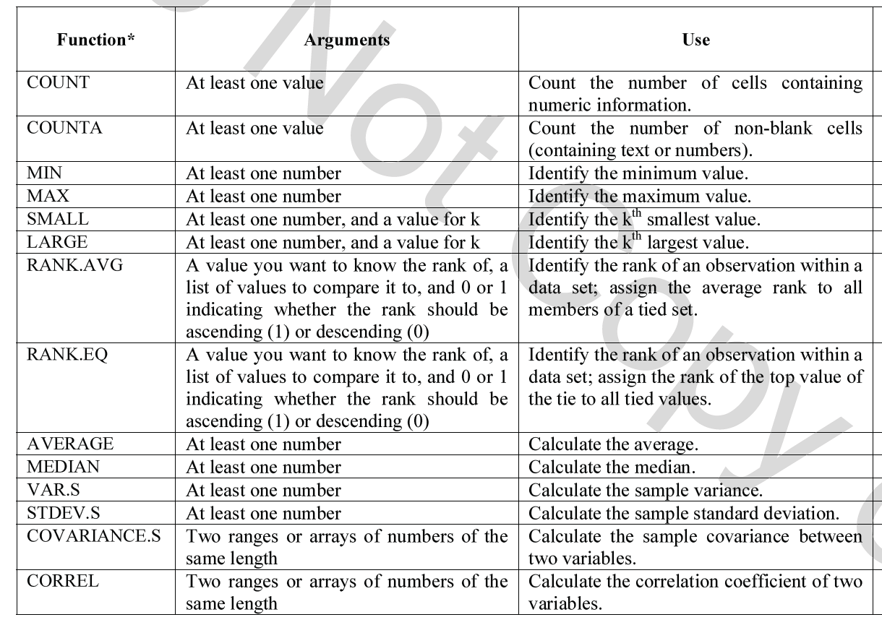
Excel Summary Table of Key Descriptive Statistics Functions

Slide 13
Managing Project Risk

Slide 14
STEP 3 – Analyze Risks
Risk = f(Probability * Impact)
Risk assessment focuses on prioritizing risks so that
an effective strategy can be formulated for those risks
that require a response.
Depends on Stakeholder risk tolerances
Can’t respond
to all risks

Slide 15
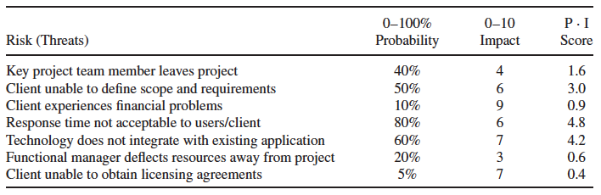
STEP 3 – Analyze Risks – Risk Impact Table
IT Project Risk Impact Analysis

Slide 16
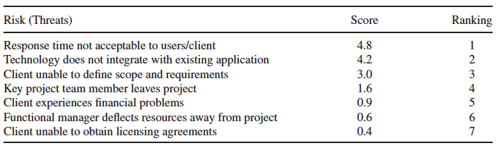
Risk Rankings

Slide 17
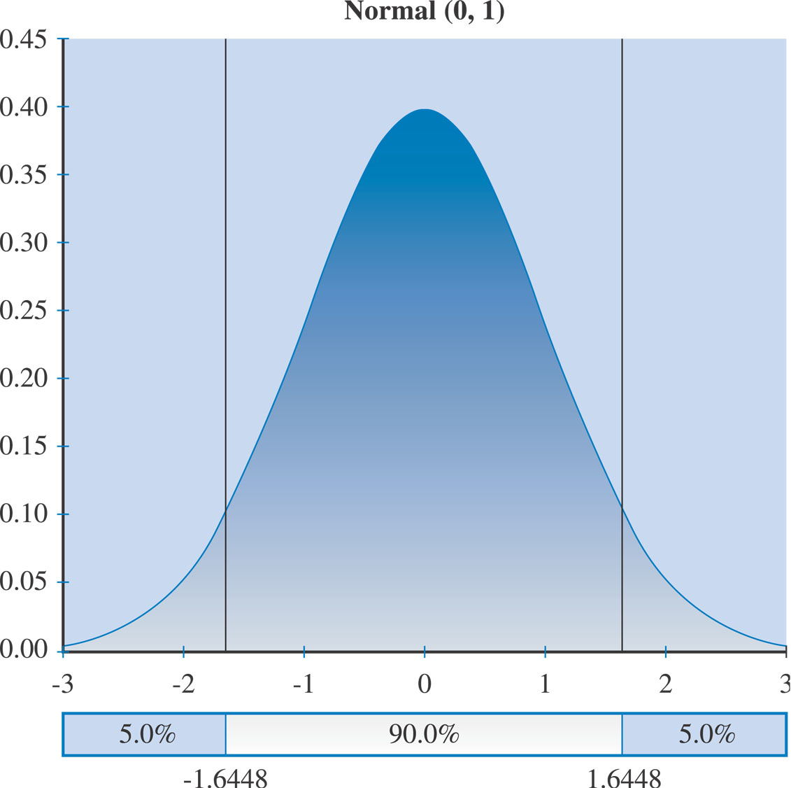
Normal Distribution

Slide 18
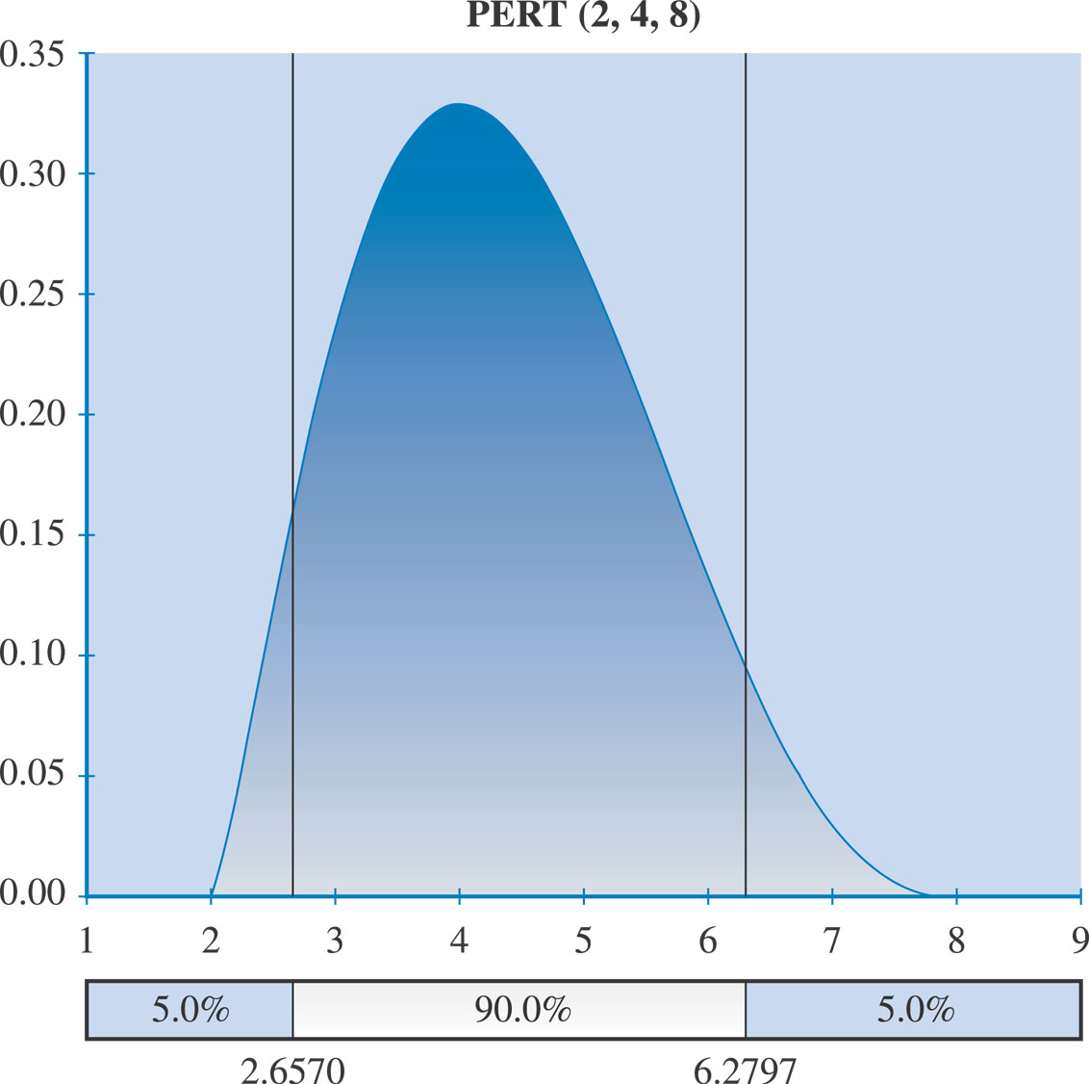
PERT Distribution

Slide 19
Risk Management In-Class Exercise Assignment

Slide 20
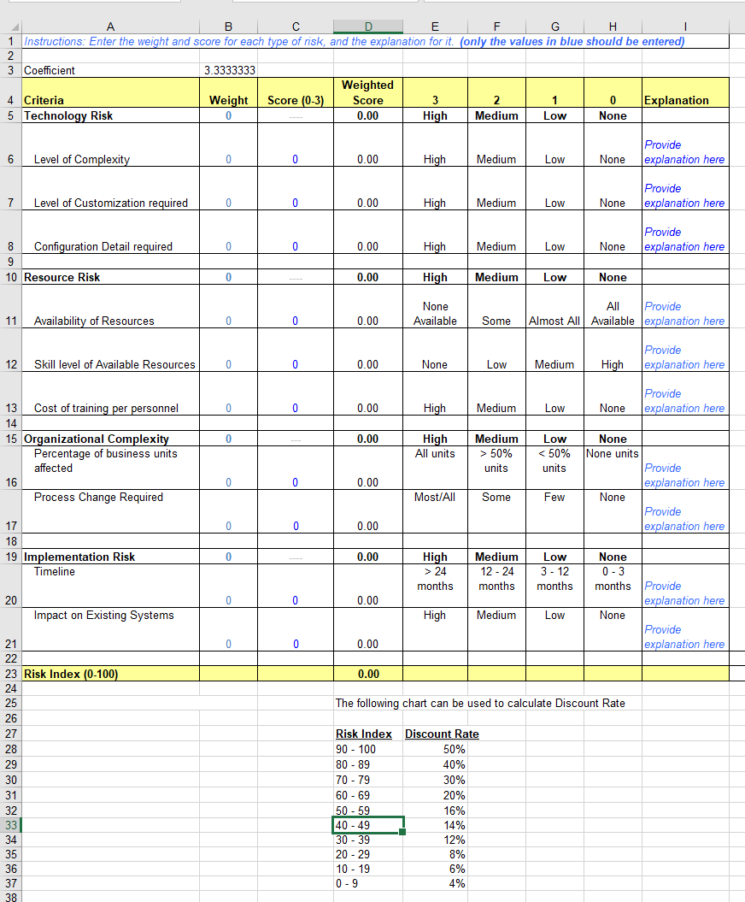
IT Risk Analysis Spreadsheet

Slide 21
Risk Management In-Class Exercise Assignment
All students submit this Risk Management In-Class Exercise Assignment on LMS by Sat Sept 29 at 9 PM (2 excel files required!)

Slide 22
In-Class CBA Exercise Answer Key

Slide 23
Risk Management Team Project Assignment
Brainstorm their Project Risks (about 10 risks)
Analyze these Risks by estimating the Probability of each Risk
Analyze these Risks by estimating the Impact of each Risk (can use an Impact Index (1-3 or 1-10) or a $ Value Impact
Rank Order these Risks by the Product of “Probability” times “Impact”
Enter the top 3 – 5 Risks in the Portfolio Management Risk (Viability) Analysis Tool (used in the Risk Management In-Class Exercise) and Calculate the “Interest Rate” to be used in their CBA
Use this Risk Adjusted Interest Rate to update their CBA
Write a “Risk Mitigation Plan” for these 3 – 5 Risks
Write a one page “Narrative” about the Risk Management Plan
Submit the “Risk Management Plan” with Spreadsheets and Narrative as one part of the “CBA” in the “Initial Sections” due Oct 9 at 9 PM

